Slide 1
Theory Of Automata

Slide 2
Text and Reference Material
Introduction to Computer Theory, by Daniel I. Cohen, John Wiley and Sons, Inc., 1991, Second Edition
Introduction to Languages and Theory of Computation, by J. C. Martin, McGraw Hill Book Co., 1997, Second Edition

Slide 3
Course Outline
PART 1
Automata and Languages:
finite automata, regular languages, pushdown automata, context-free languages, pumping lemmas.
PART 2
Computability Theory:
Turing Machines, decidability, reducibility, the arithmetic hierarchy, the recursion theorem, the Post correspondence problem.
PART 3
Complexity Theory and Applications:
time complexity, classes P and NP, NP-completeness, space complexity PSPACE, PSPACE-completeness, the polynomial hierarchy, randomized complexity, classes RP and BPP.

Slide 4
What does automata mean?
It is the plural of automaton, and it means “something that works automatically”

Slide 5
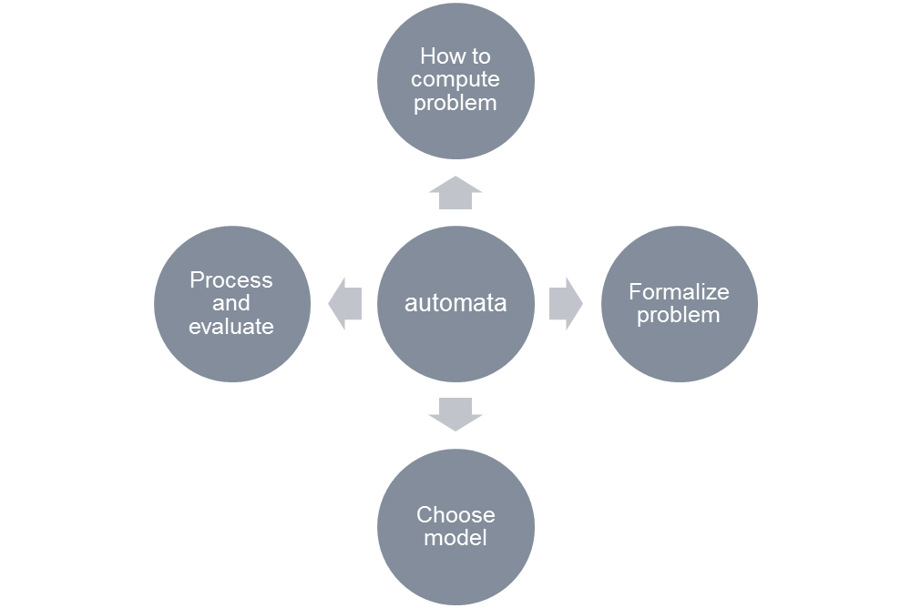

Slide 6
What is automata theory
Automata theory is the study of abstract computational devices
Abstract devices are (simplified) models of real computations
Computations happen everywhere: On your laptop, on your cell phone, in nature, …
Why do we need abstract models?

Slide 7
A simple computer
SWITCH
BATTERY
input: switch
output: light bulb
actions: flip switch
states: on, off

Slide 8
A simple computer
SWITCH
f
BATTERY
start
on
off
f
input: switch
output: light bulb
actions: f for “flip switch”
states: on, off
bulb is on if and only if there was an odd number of flips

Slide 9
A simple computer
1
1
start
off
off
1
BATTERY
2
2
2
2
1
2
off
on
1
inputs: switches 1 and 2
actions: 1 for “flip switch 1”
actions: 2 for “flip switch 2”
states: on, off
bulb is on if and only if both switches were flipped an odd number of times

Slide 10
A design problem
1
?
4
5
BATTERY
2
3
Can you design a circuit where the light is on if and only if all the switches were flipped exactly the same number of times?

Slide 11
Some highlights of the course
FINITE AUTOMATA | Devices with a finite amount of memory. Used to model “small” computers.
PUSH-DOWN AUTOMATA | Devices with infinite memory that can be accessed in a restricted way. Used to model parsers, etc.
TURING MACHINES | Devices with infinite memory. Used to model any computer.
TIME-BOUNDED TURING MACHINES | Infinite memory, but bounded running time. Used to model any computer program that runs in a “reasonable” amount of time.

Slide 12
Some highlights of the course
Finite automata
  We will understand what kinds of things a device with finite memory can do, and what it cannot do
  Introduce simulation: the ability of one device to “imitate” another device
  Introduce non-determinism: the ability of a device to make arbitrary choices
Push-down automata
  These devices are related to grammars, which describe the structure of programming (and natural) languages

Slide 13
Some highlights of the course
Turing Machines
  This is a general model of a computer, capturing anything we could ever hope to compute
  Surprisingly, there are many things that we cannot compute, for example:
  It seems that you should be able to tell just by looking at the program, but it is impossible to do!
Write a program that, given the code of another
program in C, tells if this program ever outputs
the word “hello”

Slide 14
Some highlights of the course
Time-bounded Turing Machines
  Many problems are possible to solve on a computer in principle, but take too much time in practice
  Traveling salesman: Given a list of cities, find the shortest way to visit them and come back home
  Easy in principle: Try the cities in every possible order
  Hard in practice: For 100 cities, this would take 100+ years even on the fastest computer!
Beijing
Xian
Chengdu
Shanghai
Guangzhou
Hong Kong

Slide 15
Preliminaries of automata theory
How do we formalize the question
First, we need a formal way of describing the problems that we are interested in solving
Can device A solve problem B?

Slide 16
Problems
Examples of problems we will consider
  Given a word s, does it contain the subword “fool”?
  Given a number n, is it divisible by 7?
  Given a pair of words s and t, are they the same?
  Given an expression with brackets, e.g. (()()), does every left bracket match with a subsequent right bracket?
All of these have “yes/no” answers.
There are other types of problems, that ask “Find this” or “How many of that” but we won’t look at those.

Slide 17
Fundamentals
(Sets and Theory of Proofs)

Slide 18
1.1 Mathematical Preliminaries
Sets
A set is a collection of objects
  Order and repetition is irrelevant
  X = {1, 2, 3}
  X = {n | 1 ≤ n ≤ 3, n ∈ N }
  Y = { } = ∅ ➔ Y is an empty set
The power set of X is the set of all subsets of X
  Ρ(X) = 2^{X} = { Y | Y ⊆ X}
  |Ρ(X)| = 2^{|X|}
Example X = {1, 2, 3}
  2^{X} = Ρ(X)={{},{1},{2},{3},{1,2},{1,3},{2,3}, {1,2,3}}
  {1,2} ⊂ X is a proper subset of X
  {1,2,3} ⊂ X is NOT a proper subset of X
  {1,2,3} is a superset of {1, 2}

Slide 19
Sets (2)
The ∈ symbol signifies membership (belong to):
  x ∈ X indicates that x is a member or element of the set X
  x ∉ X indicates that x is not a member or element of the set X
    Assume X = {1, 2, 3}, then
    1 ∈ X, but 4 ∉ X
Two sets are equal if they contain the same members (elements)
  If X = {1, 2, 3}, Y = {1, 2, 3}, and Z = {2, 3, 4}
  Then X = Y, but X ≠ Z, and so Y ≠ Z

Slide 20
Sets (3)
Assume X = {1,2,3} and Y = {2,4}
Union
  X ∪ Y = {z | z ∈ X or z ∈Y} = {1,2,3,4}
Intersection
  X ∩ Y = {z | z ∈ X and z ∈Y} = {2}
Difference
  X - Y = {z | z ∈ X and z ∉ Y} = {1,3}

Slide 21
Sets (4)
Complement
  Let X be a subset of Y
  The complement of X ( X ) with respect to Y is the set of elements in Y but not in X
  X = { z | z ∈ Y and z ∉ X } = Y - X
Assume X = {1,2,3} is a subset of Y = {1,2,3,4}
  X = {4}
DeMorgan’s Laws
  (X ∪ Y) = X ∩ Y
  (X ∩ Y) = X ∪ Y

Slide 22
Proofs

Slide 23
Inductive Proofs
Prove a statement S(X) about a family of objects X (e.g., integers, trees) in three parts:
  Basis Step:
    Prove for one or several small values of X directly
  Assumption step :
    Assume S(Y) for Y smaller than X
  Prove S(X) using that assumption

Slide 24
Inductive Proofs (EX1)
Prove by induction that
  S: 1 + 2 + 3 + ……+ n = n (n + 1) / 2
Basis step:
  n = 1
    1 ( 1 + 1) / 2 = 1
Assumption step:
  Assume that S is true for all series of length < n
Prove that S is true for a series of length n?
  The series of length n is
    1+2+3+…+n-1+n
    By the assumption 1+2+…+n-1 = (n-1)((n-1)+1)/2
    Add n to the summation proves S.

Slide 25
Inductive Proofs (EX2)
Example
  A complete binary tree with n leaves has 2n - 1 nodes

Slide 26
Inductive Proofs (EX2)
Basis:
  If T has 1 leaf, it is a one-node tree. 1 = 2*1 - 1, so OK
Assumption:
  Assume that the statement is true for all trees that have leaves less than n
Proof: Proof that the statement is true for trees that have n leaves
    T has two subtrees, U and V
    U has u leaves and V has v leaves
    According to the assumption: U has (2u – 1) of nodes and V has (2v – 1) of nodes
    T must be a root plus two subtrees U and V. The number of leaves in T equal number of leaves in U + number of leaves in V = u + v
    The number of nodes in T = (2u – 1) + (2v – 1) + 1 = 2 ( u + v) - 1

Slide 27
If-And-Only-If Proofs
Often, a statement we need to prove is of the form
  “X if and only if Y”
We are then required to do two things:
  Prove the if-part: Assume Y and prove X
  Prove the only-if-part: Assume X, prove Y
Remember:
  The if and only-if parts are converses of each other
One part, say “if X then Y” says nothing about whether Y is true when X is false.
An equivalent form to “if X then Y” is “if not Y then not X”; the latter is the contra-positive of the former.

Slide 28
Equivalence of Sets
Many important facts in language theory are of the form that two sets of strings, described in two different ways, are really the same set
To prove sets S and T are the same, prove:
  x is in S if and only if x is in T. That is:
    Assume x is in S; prove x is in T .
    Assume x is in T ; prove x is in S.

Slide 29
Functions
Let f be a function defined on a set A and taking values to a set B. Set A is called the domain of f; set B is called the range of f.
The arity of the functions
  The number and type of input arguments→ the number and type of output
  Examples:
    The arity of the Multiplication: Num × Num → Num
    The arity of the SquareRoot : Num → Num

